Slide 1
Transaction Processing: Concurrency control

Slide 2

Database Management System (DBMS)
Web
Forms
Embedded
SQL
Interactive
SQL
Applications
SQL Commands
DBMS
Query
Evaluation Engine
Concurrency
Control
Files and Access Methods
Recovery
Manager
Buffer Manager
Scheduler
Disk Space Manager
Database
Data
Indexes
Catalog
Notes:
Trace a transaction…

Slide 3




ACID Properties
A
C
I
D
tomicity
onsistency
solation
urability

Slide 4

ACID Properties
DBMS
Property
Dealt with by
A, D
Recovery Techniques
I | Concurrency Control Techniques
I
Concurrency Control Techniques
C
Checks, Assertions,Triggers
Applications Programmers

Slide 5
Two Views of the System
set transaction read write
select * from Students
insert into Students values (777, ‘Jane’, ‘CS’)
Commit;
Application Programmer's View
Start
sequence of SQL statements
Commit or Rollback
System developer's View
Start
sequence of Reads and Writes
Commit or Abort
Notes:
In-memory pointers only have to address all virtual memory vs. all database
4 bytes address 4 GB

Slide 6

Interleaved Transactions
T₁: UPDATE Accounts SET balance= balance + 100 WHERE client=7
T₂: UPDATE Accounts SET balance= balance + 500 WHERE client=7
Update (balance) =
Read (balance); Modify (balance); Write (balance)
Again, assume that initially balance = $1000
What happens if T₁ and T₂ are executed concurrently and they both issue Read (balance) at the same time?
If T₁ finishes last; balance = $1100
If T₂ finishes last, balance = $1500
And both values are incorrect!
Notes:
In-memory pointers only have to address all virtual memory vs. all database
4 bytes address 4 GB

Slide 7
Isolation
T₁: UPDATE Accounts SET balance= balance + 100 WHERE client=7
T₂: UPDATE Accounts SET balance= balance + 500 WHERE client=7
Isolation: The result of the execution of concurrent transactions is the same as if transactions were executed serially (one after the other)
Serializability: Operations may be interleaved, but execution must be equivalent to some sequential (serial) order of transactions
E.g., T₁ followed by T₂, or T₂ followed by T₁
Mechanism: Concurrency Control
Notes:
In-memory pointers only have to address all virtual memory vs. all database
4 bytes address 4 GB

Slide 8


Concurrency Goal
Concurrency Goal: Execute a sequence of SQL statements so they “appear” to be running in isolation
Simple Solution
Execute them in isolation!
But want to enable concurrency whenever it is safe:
High performance DBMS
Benefit from modern architectures
(e.g., multicore processors, etc.)

Slide 9
Anomalies
Question: why concurrency control is needed?
Answer: to avoid the following anomalies:
The lost update problem
The dirty read problem
The unrepeatable read problem
The phantom read
Notes:
Physical disk blocks are allocated:
Contiguous
Linked
indexed

Slide 10
Three Bad Dependencies
Lost Update: Read_{i}(X) Write_{j}(X) Write_{i}(X) sequence
Write-Write interaction (W-W)
Dirty Data: Write_{i}(X) Read_{j} (X) sequence
Write-Read interaction (W-R)
Unrepeatable Read: Read_{i}(X) Write_{j}(X) Read_{i}(X) sequence
Read-Write interaction (R-W)
These forms of inconsistency are the whole story.

Slide 11
Conflicting Operations
A conflict happens if we have two operations such that:
they belong to two different transactions, and
they both operate on the same data item,
and one of them is a write
Notes:
Physical disk blocks are allocated:
Contiguous
Linked
indexed

Slide 12
Conflicting Operations
Two operations conflict if it matters in which order they are performed
The order affects the results;
The order affects the state of the database.
Non conflicting operations are called compatible.
A compatibility table shows which operations are compatible.
E.g., {Read, Write}
 | Read | Write
Read | yes | no
Write | No | no

Slide 13
Schedules
When transactions are executing concurrently, the order of execution of operations from all transactions is known as a schedule (or history)
A Schedule S of n transactions T₁, T₂, …, T_{n} is an ordering of the operations of the transactions
For the purpose of concurrency control, we are mainly interested in the read (r) and write (w) operations, as well as commit (c) and abort (a) operations

Slide 14
ANSI SQL2 Isolation Levels
SET TRANSACTION READ ONLY | READ WRITE
[ ISOLATION LEVEL READ UNCOMMITTED |
READ COMMIT |
REPEATABLE READ |
SERIALIZABLE ]

Slide 15
Concurrency Control Schemes
Lock-based CC schemes
Two-phase locking [IBM DB2, SQLServer]
Multigranularity locking
Tree/Index locking
Multiversion [PostgreSQL, Oracle, SQLServer]
Timestamp-based
Optimistic CC & Certifiers

Slide 16

Lock Based Concurrency Control
Locking is the most common synchronization mechanism
A lock is associated with each data item in the database
A lock on item “x” indicates that a transaction is performing an operation (read or write) on “x”.
Notes:
Physical disk blocks are allocated:
Contiguous
Linked
indexed

Slide 17


Lock Based Concurrency Control
Transaction T_{i} can issue the following operations on item x:
read_lock (x)
x is read-locked by T_{i}
shared lock: other transactions are allowed to read x
write_lock (x)
x is write-locked by T_{i}
exclusive lock: single transaction holds the lock on x
unlock (x)
Notes:
Physical disk blocks are allocated:
Contiguous
Linked
indexed

Slide 18
Basic Two Phase Locking (2PL)
Growing
Shrinking
A scheduler following the 2PL protocol has two phases:
A Growing phase
Whenever the scheduler receives an operation on any item, it must acquire a lock on that item before executing the operation.
No locks can be released in this phase
A Shrinking phase
Once a scheduler has released a lock for a transaction, it cannot request any additional locks on any data item for this transaction.
Notes:
Physical disk blocks are allocated:
Contiguous
Linked
indexed

Slide 19
Basic Two Phase Locking (2PL)
Example:
Transaction T: a = r(x); w(y, a);
S₁:read_lock(x); a=r(x); write_lock(y); w(y, a); unlock(x); unlock(y);
✔
S₂:read_lock(x); a=r(x); unlock(x); write_lock(y); w(y, a); unlock(y);
✗
S₃:read_lock(x); a=r(x); write_lock(y); unlock(x); w(y, a); unlock(y);
✔
Notes:
Physical disk blocks are allocated:
Contiguous
Linked
indexed

Slide 20
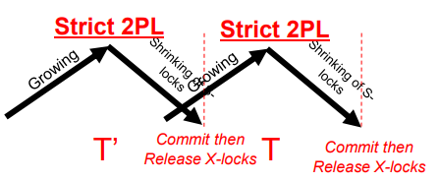
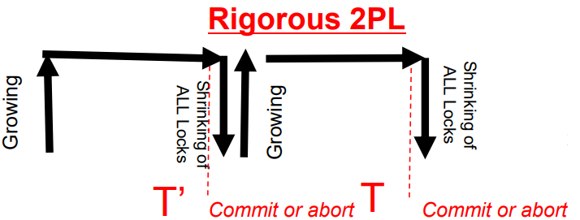
Rigorous 2PL or industrial Strict 2PL
The growing phase
transactions request locks just before they operate on a data item.
The growing phase ends at commit time.
no locks can be released until commit or abort time.
no overwriting of dirty data.
no overwriting of data read by active transactions.
no reading of dirty data.
Easy to implement a strict 2PL. Why ?
Has a functional advantage. What ?
Notes:
It is an aggressive (dynamic) 2PL

Slide 21

Deadlocks

Slide 22
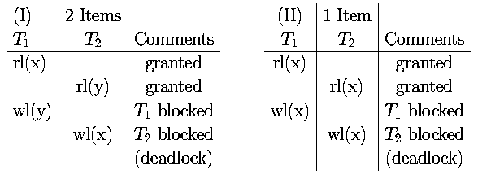
Deadlocks
Examples:
Example II involves lock conversion
The scheduler restarts any transaction aborted due to deadlock.

Slide 23
Deadlocks
A deadlock occurs when two or more transactions are blocked indefinitely.
This happens because each holds locks on data items on which the other transaction(s) attempt to place a conflicting lock.
Necessary conditions for deadlock situations.
mutual exclusion
hold and wait
no preemption
circular wait.

Slide 24
Deadlock Handling Schemes
Deadlock avoidance
Timestamp ordering (Wait-Die, Wound-Wait)
Deadlock Prevention
Predeclaration of resources,…
Deadlock Detection and Resolution
Time-out
Wait-for graphs

Slide 25

Issues Related to Locking
Deadlock
Livelock
Starvation

Slide 26
Concurrency Control Schemes
Lock-based CC schemes
Two-phase locking [IBM DB2, SQLServer]
Multigranularity locking
Tree/Index locking
Multiversion [Oracle, SQLServer]
Timestamp-based
Optimistic CC & Certifiers

Slide 27
Multiversion Concurrency Control
Assume the following sequence of events.
W₀(x) C₀ W₂ (x) R₁(x) C₂ C₁
This sequence CANNOT be produced by a strict 2PL scheduler
T₁ can not read lock x until after C₂
An Idea !!
If we had kept the old version of x when W₂ (x), then we could avoid having to delay T₁ as in 2PL by having T₁ read the previous (old) value of x (produced by T₀).

Slide 28
Basic Idea
The DBMS keeps a list of versions for each x
Version x_{i} means the version of x produced by a Write on x by transaction T_{i}
Each Write(x) produces a new version of x
When the scheduler receives a R_{i} (x), it must decide which version of x to read
A Read operation will be converted to the form R_{i}(x_{i})
If a transaction T is aborted, any version it created is destroyed
If a transaction T is committed, any version it created becomes available for reading by other transactions

Slide 29
Two Version 2PL (2V2PL)
keep one or two versions of each data item x.
When a T_{i} wants to write x, it sets a wl(x) and creates a new version of x, x_{i}.
The wl(x) prohibits other transactions from writing x.
Readers are allowed to place a rl on their write-locked x or the previous version of x.
When T_{i} commits, the x_{i} version of x becomes x's unique version (the previous x may now be deleted).
To delete the previous x when T_{i} commits, we need to know that no other transaction reads x.
Request a commit lock (cl) which conflict with rl
Deadlocks are possible and indicate non-CSR execution
use any deadlock detection or prevention technique.
Notes:
T1 tries to convert its rl on x to wl
T2 tries to convert its wl on x to cl

Slide 30
Example
W₀(x) C₀ R₃(x) W₂(x) R₁(x) C₂ C₁ C₃
W₀(x₀) C₀ C₀(x₀) R₃(x₀) W₂(x₂) R₁(x₀) C₂ C₁ C₃ C₂(x₂)
rl
rl
wl
cl
ul
ul
ul
wl
cl
ul
✗
✗
✗
U
C
U
C
X₀
X₀
X₂
X₂

Slide 31
Postgres Isolation Levels
SET TRANSACTION READ ONLY | READ WRITE
[ ISOLATION LEVEL READ UNCOMMITTED |
READ COMMIT |
REPEATABLE READ |
SERIALIZABLE ]
READ COMMITTED is the default
Not always the most recent/latest one
It cannot see even its own uncommitted updates
REPEADABLE READS always, Why?
JDBC: dbcon.TRANSACTION_READ_COMMITTED, dbcon.TRANSACTION_SERIALIZABLE

